Slide 1
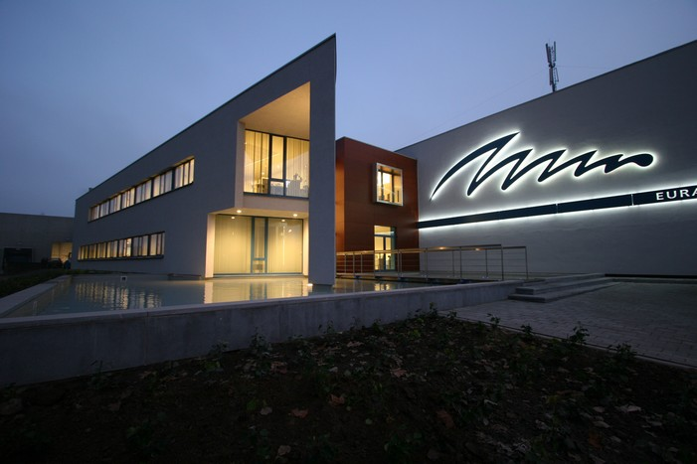




Slide 2
Company presentation
Pollet Water Group
Euraqua Europe
  Guided Plant Visit

Slide 3

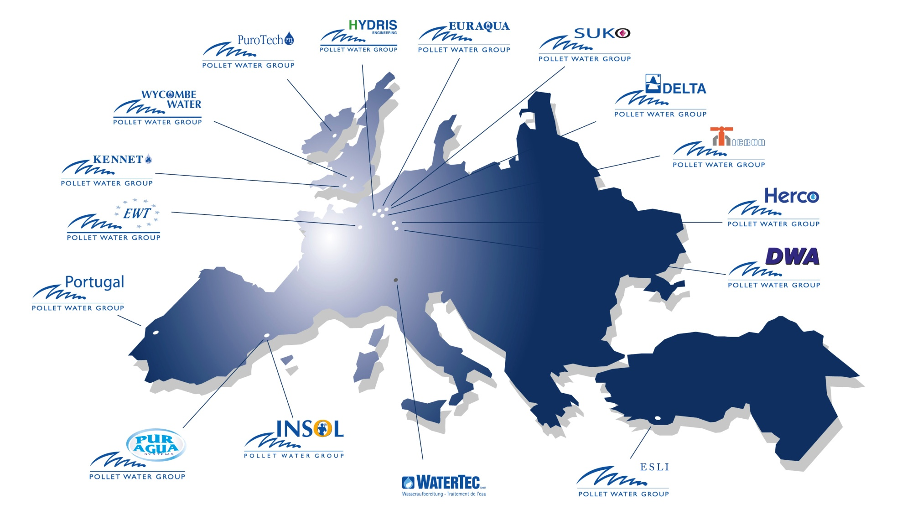

Slide 4
Head quarters : Waregem – Belgium
Turnover : + 140 Mio €
Employees : + 750
20 affiliates all over Europe
B2B in process- and drinking-water applications
Centralized Procurement
Support: IT and Marketing

Slide 5
Head quarters : Waregem - Belgium
Founded 1975 - Member of PWG since 1992
Turn-over : €17 Mio - # employees : 35
15.000 sq.m stock – 20.000 domestic softeners/year
Role
  To PWG :
    Central warehouse
    Assembly softening & filtration
  To Third customers : commercial action radius:
    Benelux
    Nothern Europe: Scandinavia, Germany
    Eastern Europe, Baltic States
    CIS (Commonwealth of Independent States)

Slide 6
Where we stand for:
  30 years of experience in the industry
  Operates throughout Europe, Africa and Middle East
  Supplying both components and complete systems to
  water treatment companies
  Systems under Own brand and Private label
  Extensive stock-holding
  Wide variety of components, multi brand and exclusivities
  Experienced sales and technical support team

Slide 7
Our Mission
To be the reliable manufacturer and distributor for professional
B-to-B partners in water treatment.
To be the expert in water treatment, delivering total solutions.
To deliver added value by means of know-how and service.

Slide 8
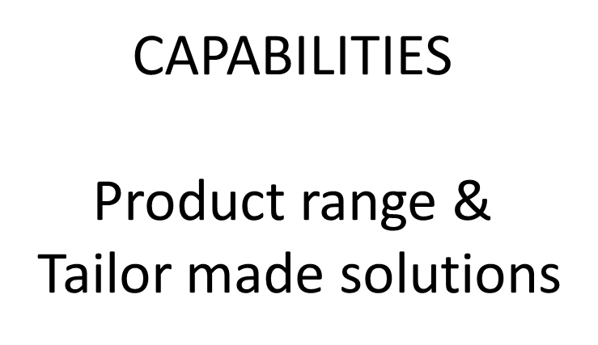

Slide 9
Standard products
Individual Components
  Valves: Clack, Fleck, Siata, Autotrol, WaterRight,...
  Tanks: Structural, PWG vessels, Galva, Steelpex, …
  Distribution systems
  Cabinets : Pentair, own brands: Swan, Flamingo, Laser, PWG 860
  Brine Tanks
  Membranes : Hydranautics
  Resins : Dow, Purolite, Lanxess, Indion
  Filter media for all main filtration purposes
  Filters : Atlas Filtri, Cintropur
  UV systems: SITA, Cintropur
  All other components for softening & filtration

Slide 10
Standard products
Assembled products
  Softening - Iron removal & filtering
    Monobloc & Duobloc
    Simplex & Duplex
    Residential & Industrial
  Reverse Osmosis
    Residential & Industrial

Slide 11
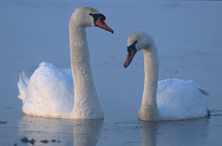
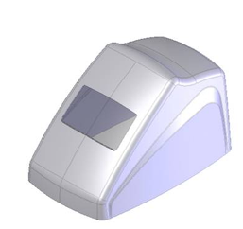
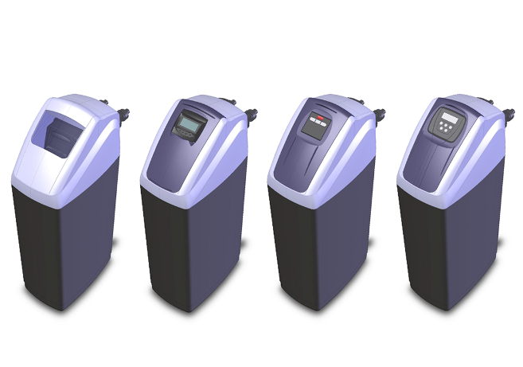
Own brand
Inhouse developments
Swan & Flamingo
Cabinets

Slide 12
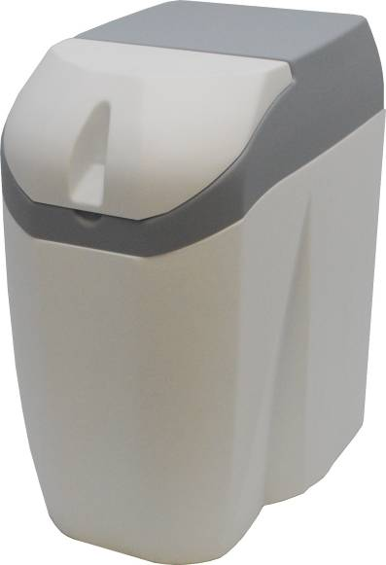
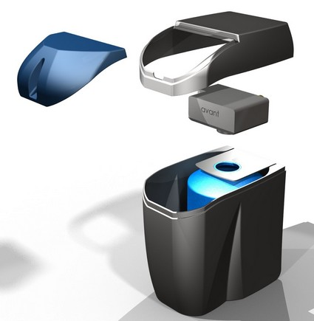
Own brand
Inhouse developments
Laser
Compact Monobloc

Slide 13
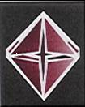

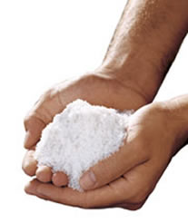
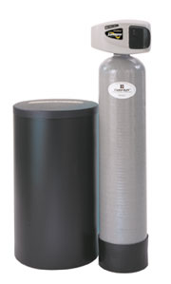
Residential iron removal

Slide 14
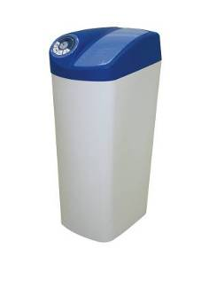
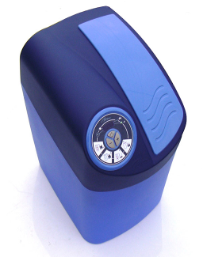

Exclusive development with valve manufacturers
+

Slide 15
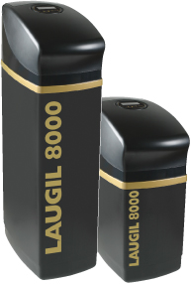
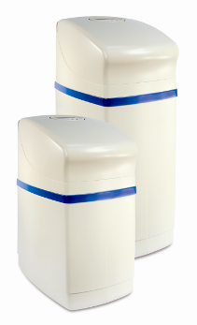

Exclusive development with valve manufacturers
+

Slide 16
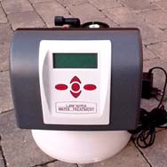
Exclusive valves WaterRight
Impression /Pro
Sanitizer /Pro
WaterCare /Pro
Clack CK

Slide 17
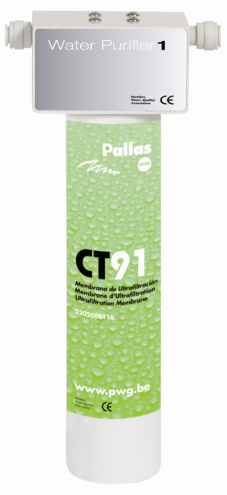


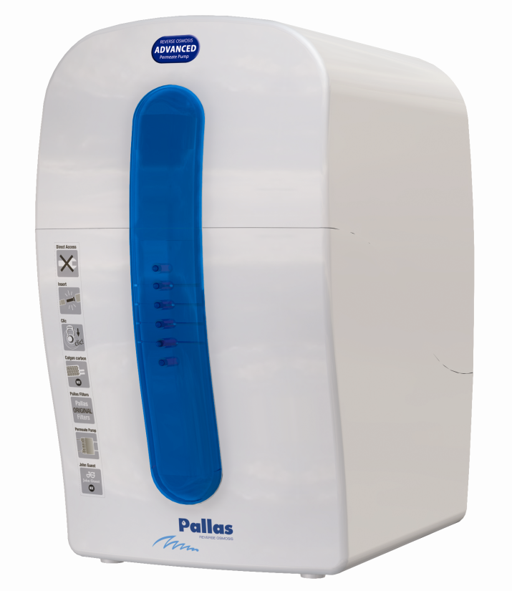
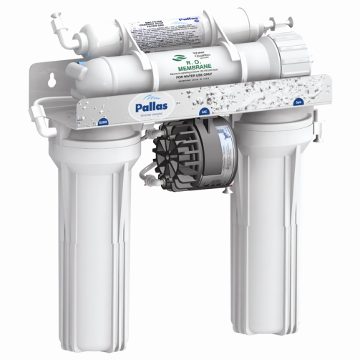
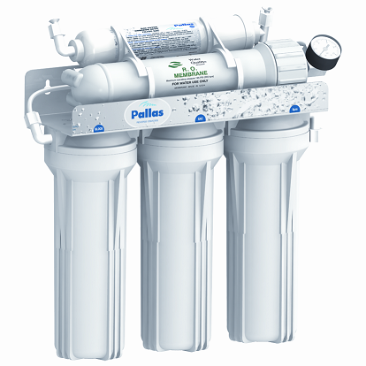
Residential dead end filtration & reverse osmosis

Slide 18
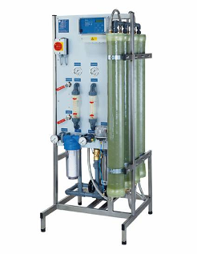
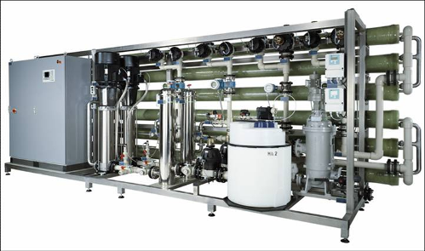
Own brand
Herco Industrial RO
High end installations
Wet tested
Orbital welding

Slide 19
Own brand
ESLI Industrial RO: Aqualine
Price / Quality

Slide 20
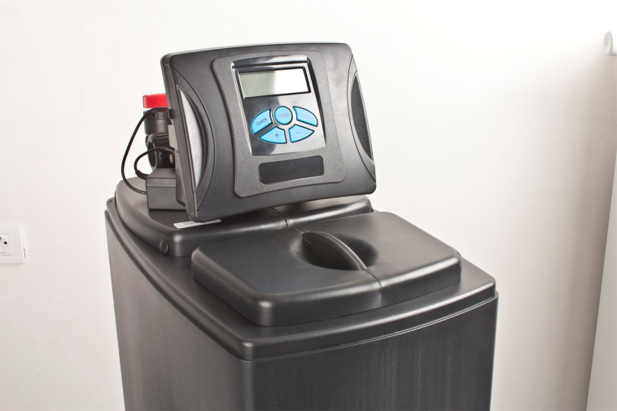
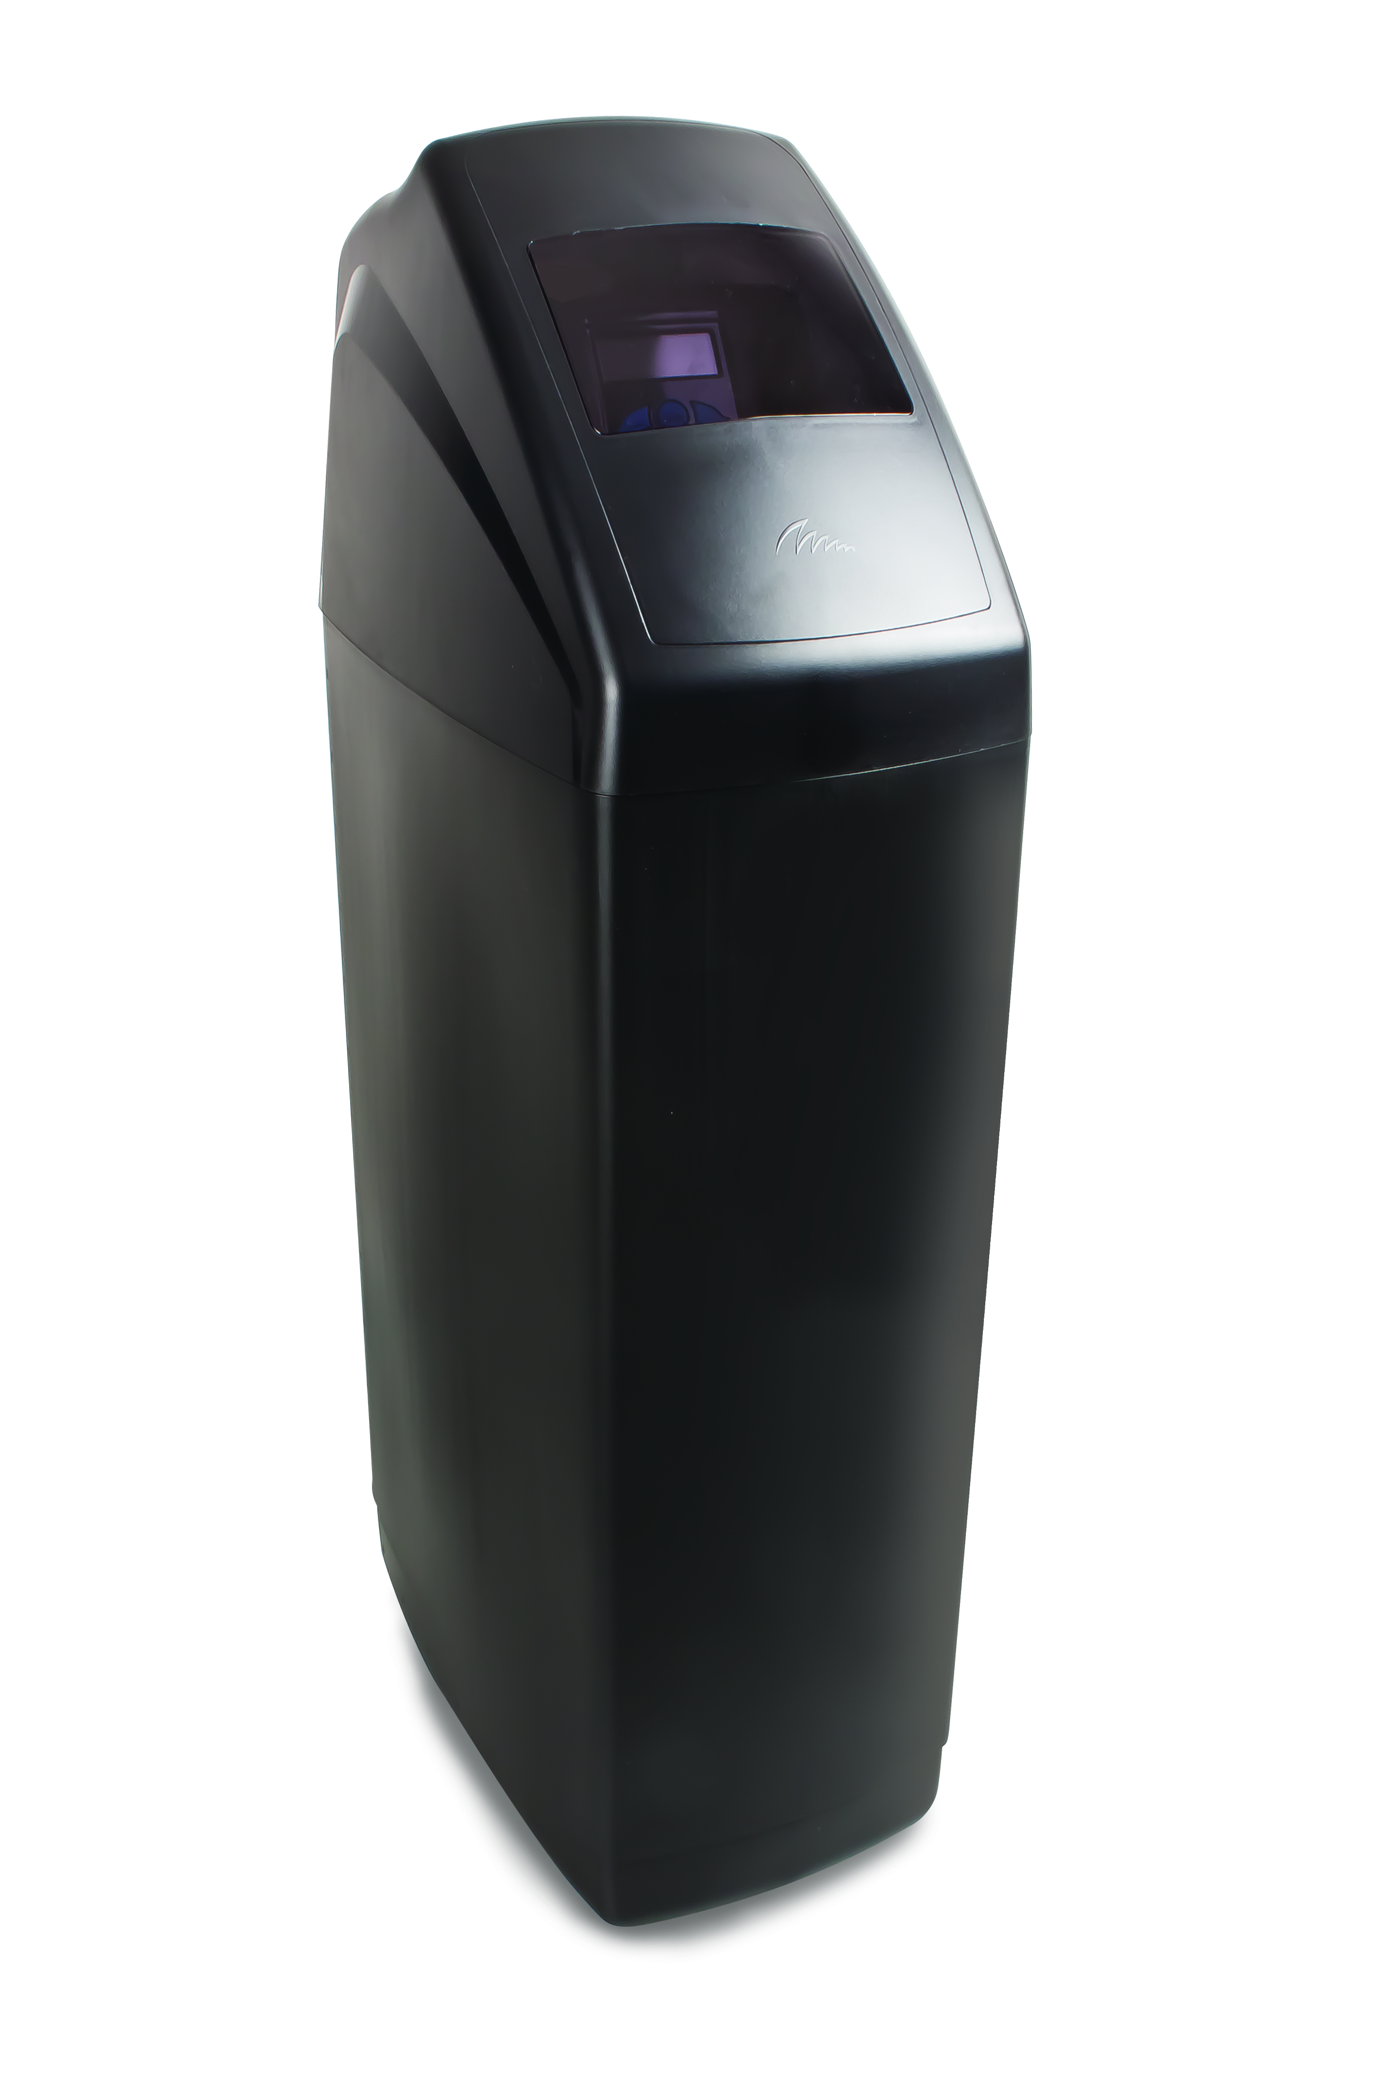
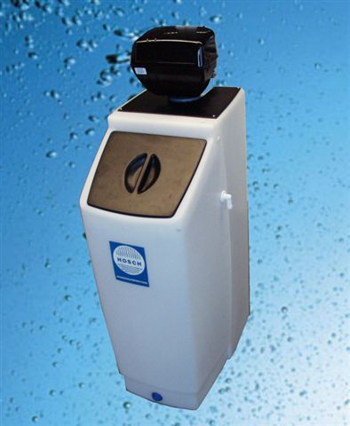
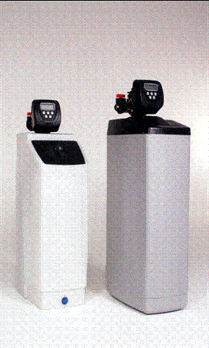
Tailor made & Private label solutions
Softeners

Slide 21
Tailor made & Private label solutions
Cabinets

Slide 22













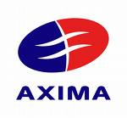

Some of our satisfied customers
Water treatment companies
Sanitary companies
OEM companies
Maintenance companies

